Slide 1
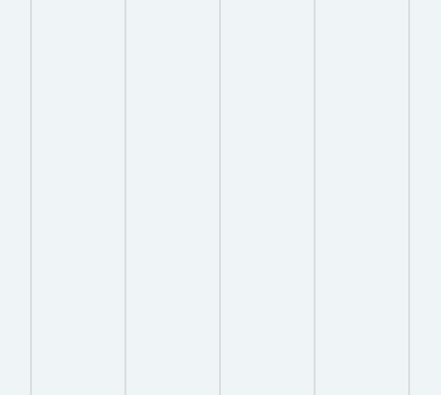




.NET CORE
MICROSERVICES
THE COMPLETE GUIDE
BHRUGEN PATEL

Slide 2

What is Microservice?
How to correctly implement Microservice?

Slide 3

OUTDATE COURSE!

Slide 4
.NET Core
EF Core
API

Slide 5
VS 2022 .NET 8
SQL Server
Azure Subscrption

Slide 6
Course Overview
WHY MICROSERVICES?
Independently Deployable
Independently Scalable.
No Bulky Code.
Reduce Downtime.

Slide 7
MICROSERVICES
Frontend Web Application
EMAIL
PRODUCT
SHOPPING CART
ORDER

Slide 8
Shopping Cart Logic
User adds first item to the Cart
- Create Cart Header
- Create Cart Details
User adds a new item in the shopping cart. (User already has few other items in cart)
- Find Cart Header
- Add Cart Details under same Cart Header Id
User updates quantity of an existing item in the cart
- Find Details
- Update Count in Cart Details

Slide 9
OAuth2 and OpenID Connect
OAuth2
OpenID Connect
Authorization
Works with Access_token
Built on top of Auth2

Slide 10
What this course is NOT about?
DOCKER!
MULTIPLE
TECHNOLOGY

Slide 11
What this course is NOT about?

Slide 12





Identity Provider
Client

Slide 13


IdentityServer 5 / Duende Identity Server
IdentityServer5 (Duende Identity Server)
https://docs.duendesoftware.com/identityserver/v5
IdentityServer is an implementation of OpenID Connect and OAuth2 and is highly optimized to solve the typical security problems of today’s mobile, native and web applications.

Slide 15
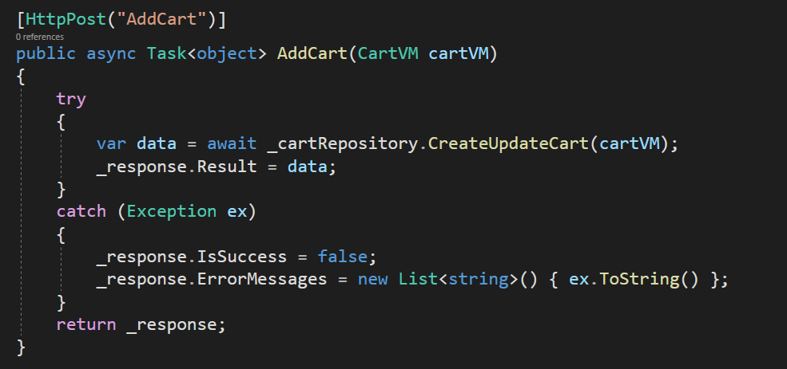
ASYNC AWAIT WITHIN CODE

Slide 16
Microservices
Application contains multiple loosely coupled microservices
Individual Technology Stack
Communication between microservices
Separation of Concern

Slide 17

Microservices Application Flow
:7002
.NET Identity
MVC Application
:7000
Product
:7001
Coupon
Email
Gateway
Shopping Cart
Service Bus
:7777
:7003
:7004
Rewards
Order

Slide 18
Traditional Monolith Application
ASP.NET Core Application
Product Component
Shopping Cart Component
Order Component
Models
Views
Controller
Repository
Service
…
Models
Views
Controller
Repository
Service
…
Models
Views
Controller
Repository
Service
…

Slide 19
Microservices Application
ASP.NET Core Application
Models, Views, Controllers…
ASP.NET Core Application
ASP.NET Core Application
ASP.NET Core Application
Product Component
Shopping Cart Component
Order Component
Models
Views
Controller
Repository
Service
…
Models
Views
Controller
Repository
Service
…
Models
Views
Controller
Repository
Service
…

Slide 20
COMMUNICATION (SYNC/ASYNC)
SYNCHRONOUS COMMUNICATION -
Synchronous communication was never a problem in relatively small monolithic applications because it is a very simple concept to reason about.
The client sends a request to the server, and the server responds to the client.
An advantage of synchronous communication is that the service receives an acknowledgement that the request was received, and the corresponding action was executed.
ASYNCHRONOUS COMMUNICATION -
When using asynchronous communication, the calling service does not wait for a response from the called service.
Asynchronous communication also allows the possibility of One-To-Many communication, where a client can send a message to multiple services at once.

Slide 21
Microservices Application Flow
:7002
.NET Identity
MVC Application
:7000
Product
:7001
Coupon
Email
Gateway
Shopping Cart
Service Bus
:7777
:7003
:7004
Rewards
Order

Slide 22
Identity Server Terminology
Client
Identity Resource
API Resource
Identity Token
Access Token

Slide 23
Azure Messaging
Azure Storage Queues
Azure Service Bus
Azure Storage Queue is a service for storing large numbers of messages
Microsoft Azure Service Bus is a message broker with message queues and publish-subscribe topics.

Slide 24
TOOLS NEEDED
01
03
VISUAL STUDIO 2019
.NET 6
02
04
SQL SERVER 2018
AZURE SUBSCRIPTION

Slide 25
Microservices Application Flow (Without Gateway)
:7002
.NET Identity
MVC Application
:7000
Product
:7001
Coupon
Email
Shopping Cart
Service Bus
:7003
:7004
Rewards
Order

Slide 26
Microservices Application Flow (With Gateway)
:7002
.NET Identity
MVC Application
:7000
Product
:7001
Coupon
Email
Gateway
Shopping Cart
Service Bus
:7777
:7003
:7004
Rewards
Order

Slide 27
Client-to-microservice Communication
Client communicates directly with all the microservices in this architecture.

Slide 28

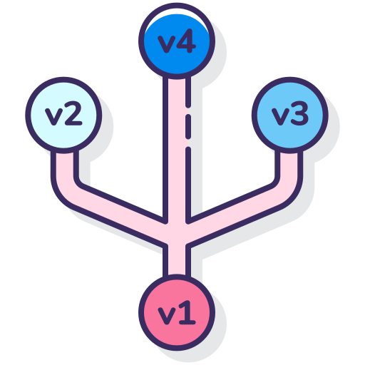

Disadvantages of Client-to-microservice
Tight coupling
Security
Monitoring API

Slide 29

Adding a Gateway
Single point of entry to set of services
Easier Security Management
Larger application

Slide 30


Disadvantages of Gateway
Tight coupling
Extra layer
Development

Slide 31
01
OVERVIEW
Here you could describe the topic of the section

Slide 32
02
PRODUCT API BASIC SETUP

Slide 33
BRIEF INTRODUCTION
Venus has a beautiful name and is the second planet from the Sun. It’s terribly hot—even hotter than Mercury—and its atmosphere is extremely poisonous

Slide 34
01
OVERVIEW
Here you could describe the topic of the section

Slide 35
“This is a quote. Words full of wisdom that someone important said and can make the reader get inspired.”
—SOMEONE FAMOUS

Slide 36

RabbitMQ
Open-source messaging system
RabbitMQ implements the AMQP protocol
RabbitMQ Includes
Reliability
Routing
Browser based UI
Cross-platform

Slide 37
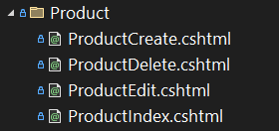
ASSIGNMENT – PRODUCT API
Setup Product API Database / Tables
Setup DbContext and Seed Product Table
Setup AutoMapper
CRUD functionality Product API
Setup Authentication & Authorization in API
Create/Edit/Delete – ADMIN Role
Read – Any Authorized User
Web Project to Consume API (Product API Port – 7000)
Implement Product Service and Controller in Web Project
Views for Product CRUD Operations

Slide 38
EXCHANGE
Exchange
Queue
Routes
RabbitMQ Message Broker

Slide 39
EXCHANGE TYPES
DIRECT EXCHANGE
FANOUT EXCHANGE
TOPIC EXCHANGE
HEADER EXCHANGE

Slide 40
DIRECT EXCHANGE
Direct Exchange
Queue
Routes
RabbitMQ Message Broker

Slide 41
DIRECT EXCHANGE
Publisher
Queue
Consumer
Direct Exchange
Routes
Routing Key = checkoutQueue
RabbitMQ Message Broker

Slide 42
FANOUT EXCHANGE
Queue
Fanout Exchange
Queue
Routes
Queue
RabbitMQ Message Broker

Slide 43
TOPIC EXCHANGE
*.newCustomer.*
Queue
*.platinumCustomer.*
Topic Exchange
Queue
Routes
Routing Key:
all.email.*
*.*.*
Queue
RabbitMQ Message Broker

Slide 44
HEADER EXCHANGE
Role = basicCustomer
Type= promotional
Queue
HEADER Exchange
Role = platinumCustomer
Type= educational
Queue
RabbitMQ Message Broker

Slide 45
QUEUES
Queue
Name | Name of the queue
Durable | Persist the queue to disk
Exclusive | Delete queue when not needed
Auto Delete | Queue deleted when consumer unsubscribes

Slide 46
BINDINGS
Queue
Binding
Exchange
Binding
Queue
RabbitMQ Message Broker

Slide 47
STANDARD QUEUE
Publisher
Queue
Consumer
RabbitMQ Message Broker

Slide 48
STANDARD QUEUE
Publisher
Queue
Consumer
Direct Exchange
Routes
Routing Key = checkoutQueue
RabbitMQ Message Broker

Slide 49
DIRECT ROUTING
PaymentEmail
Queue
Consumer
Publisher
Direct Exchange
PaymentOrder
Queue
Consumer
RabbitMQ Message Broker

Slide 50
PUBLISH AND SUBSCRIBE
Queue
Consumer
Publisher
Exchange
Queue
Consumer
RabbitMQ Message Broker

